Slide 1

SDM INSTITUTE OF TECHNOLOGY
DEPARTMENT OF ARTIFICIAL INTELLIGENCE & DATA SCIENCE ENGINEERING
Presented By : Deekishith(4SU22AD010)
Jeevan (4SU22AD018)
Darshan (4SU22AD009)

Slide 2
BOOKSTORE MANAGEMENT SYSTEM

Slide 3
Contents:-
1.Introduction.
2.The Software used in backend and front end.
4.ER Diagram.
5.Schema Diagram.
6.Queries.
7. Conclusion.

Slide 4
1.Introduction:-
A Bookstore Management System (BMS) is a software application designed to streamline the operations of a bookstore by integrating various functions such as inventory management, sales processing, customer relationship management, and supplier coordination. It allows for efficient tracking of book stock, processing of sales transactions, and generation of detailed reports for analysis. The system enhances accuracy in managing book details, billing, and customer records, ultimately improving customer satisfaction and operational efficiency.

Slide 5
2.The Software used in backend and front end:-
Back End : MySQL, MongoDB
Tools & Technologies : Wamp Server,
MySQL Queries,
Browser (Mozila Firefox, Chrome..)
Text Editor(Sublime Text 3, Notepad ++..)
In developing a comprehensive Bookstore Management System (BMS) For the backend, using robust programming languages such as Java, Python and Databases such as MySQL, PostgreSQL, or MongoDB provide reliable data storage solutions facilitate seamless communication between the client and server.

Slide 6
Front End: HTML, CSS, JavaScript
Tools & Technologies : Visual Studio Code, Notepad++(Text Editor)
Mozilla Firefox, Microsoft Edge(Browser)
GitHub(Version Control)
On the frontend, utilizing HTML, CSS, and JavaScript, alongside powerful frameworks and libraries like Query, enhances the user interface and experience. Essential development tools like Visual Studio Code and Notepad++, combined with browsers like Mozilla Firefox and Microsoft Edge, streamline the development process. Version control with Git and platforms like GitHub, along with tools like Webpack, Babel, npm, and Yarn, further support efficient project management and deployment.

Slide 7
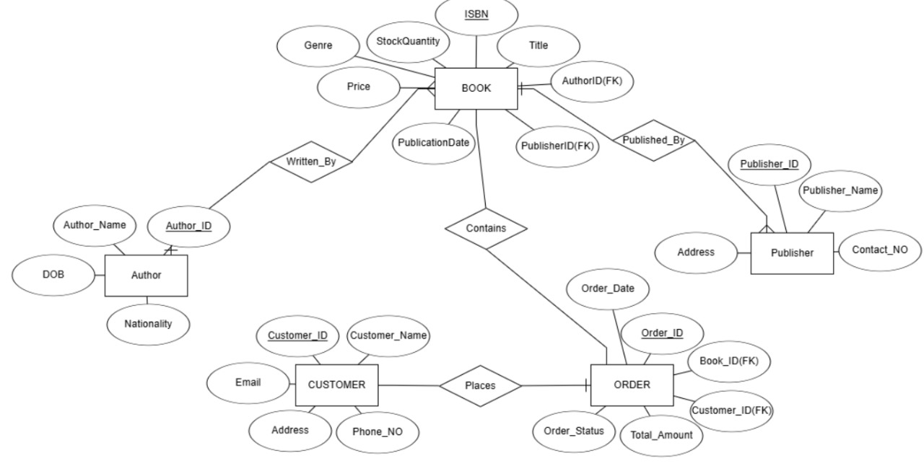
4.ER Diagram:-

Slide 8
4.Schema Diagram:-
Book
B_ID | TITLE | AUTHOR_ID | PUBLISHER_ID | PUBLICATION_DATE | PRICE | GENRE | STOCK_QNTY
Author
AUTHOR_ID | AUTHOR_NAME | DOB | NATIONALITY
Publisher
PUBLISHER_ID | PUBLISHER_NAME | CONTACT_NO | ADDRESS
Order
CUSTOMER_ID | CUSTOMER_NAME | EMAIL | ADDRESS | PHONE_NO
Customer
ORDER_ID | ORDER_DATE | BOOK_ID | CUSTOMER_ID | TOTAL_AMOUNT | ORDER_STATUS

Slide 9
In summary, the Entity-Relationship (ER) diagram is an essential tool for designing and understanding the structure of a database system.
This ER diagram provides a clear and comprehensive blueprint for developing a Book Management System, ensuring that the database is logically structured and capable of handling various operations related to books, customers, and transactions. Understanding and implementing such a diagram is fundamental to building robust, scalable, and efficient database systems.

Slide 10
1.Find all books by a specific author along with their publisher information:-
SELECT
b.Title AS BookTitle,
b.ISBN,
p.Name AS PublisherName,
p.ContactInformation
FROM Book b
JOIN Book_Author ba ON b.BookID = ba.BookIDJOIN Author a ON ba.AuthorID = a.AuthorIDJOIN Publisher p ON b.PublisherID = p.PublisherIDWHERE a.Name = 'Specific Author Name';

